Slide 1



SECRETARY OF HEALTH NATIONAL SURVEILLANCE LABORATORY
NATIONAL HIV LABORATORY
QUALITY ASSURANCE OF TESTS IN NON-CONVENTIONAL ENVIRONMENTS.
EXPERIENCE IN HONDURAS
DRA RITA ISABEL MEZA MSc.
CHIEF NATIONAL HIV LABORATORY – HONDURAS
Agosto 2024

Slide 2


INTRODUCTION
In recent years, quality assurance in HIV testing in non-conventional settings has become increasingly important in the global response to the HIV pandemic.
In countries like Honduras, expanding testing to non-conventional settings has become a crucial strategy to improve HIV detection and treatment. These unconventional environments may include primary health care units, non-governmental organizations, and mobile services, among others.

Slide 3
OBJECTIVES OF QUALITY ASSURANCE OF TESTS IN NON-CONVENTIONAL ENVIRONMENTS
Expand coverage for HIV diagnosis
Obtain reliable and accurate results through quality assurance
Train in proficiency panels with the use of the Dry Tube Sample (DTS) methodology - EQCP entry
Comprehensive care coordinated through counseling, navigation and linkage

Slide 4
DEVELOPMENT OF POLICIES AND PROCEDURES
As of 2017, the National HIV Laboratory has included within national regulations policies and guidelines
Definition of Quality Objectives: Has established policies that clearly define quality objectives, these objectives are specific, measurable and achievable
Rules and Regulations: The policies comply with current regulations and standards and are aligned with the regulations for the care of people with HIV.
Responsibilities and Roles: The responsibilities and roles of each staff member in relation to quality have been clearly defined. This helps ensure that everyone understands their roles and expectations in terms of quality.

Slide 5



UNIT NETWORK OF HEALTH UNITS WITH AND WITHOUT LABORATORY AND NON-GOVERNMENTAL ORGANIZATIONS/IMPLEMENTING PARTNERS
826 Health establishments (46% with laboratory)
6 NGO/ Implementing partner

Slide 6
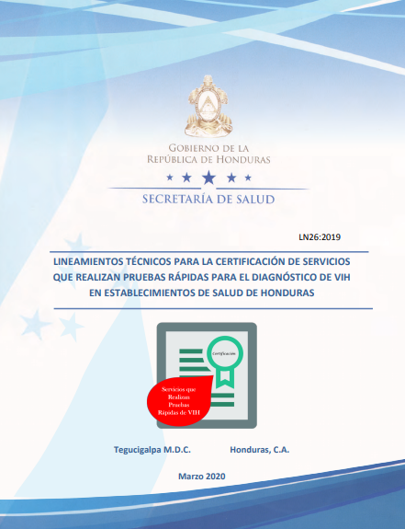

NATIONAL GUIDELINES

Slide 7

TRAINING OF STAFF WHO PERFORM RAPID HIV TESTS
Generalities
Purpose
Objetives
Develop staff capabilities and skills to provide reliable diagnostics.
Ensure quality and biosafety
Implement compliance with the checklist to improve test quality and site certification (SPI-RT)
This training program seeks to strengthen quality management systems in services that perform rapid HIV testing, so that personnel trained by trainers can be certified.
The curriculum is based on the information contained in 11 modules

Slide 8


STAFF PROFILE
This training program was developed to update and evaluate the performance of personnel who perform rapid HIV diagnostic tests, to ensure competency over time. The personnel who participate in this training may be:
Nursing staff (professional nurses and/or nursing assistants) working in the public sector trained in risk-based counseling.
Personnel who work in the field of HIV control and prevention in private establishments and non-governmental organizations trained in risk-based counseling

Slide 9
CONTENT OF THE MODULES TO CERTIFY PERSONNEL
Epidemiology of HIV in Honduras
Introduction to the quality assurance cycle
Description of rapid HIV tests
Safety at HIV testing sites
1
2
3
4
Introduction to DTS Proficiency Testing
Sample collection by digital puncture
Rapid HIV testing algorithm
HIV Testing Registry
8
5
6
7
Professional ethics
Introduction to certification guidelines
Assessment
Practical theoretical exam
Counseling and testing clinic
Brigade monitors
9
10
11

Slide 10
TRAINING METHODOLOGY
This face-to-face interactive training program with a duration of 40 hours divided into 5 days of theoretical and practical workshop
Theoretical and practical exam (exam application format, HIV monthly report, use standardized record book)
Professional ethics-exercises
Reading and interpretation of results
Fingerstick practice for three days in a health facility
Interpretation of results
Diagnostic algorithm
Practice dry tube sample

Slide 11
TRAINING METHODOLOGY
Requirement
Be support staff for HIV prevention and control activities in coordination with the SESAL
Number of participants:
Minimum of 5 participants with a maximum of 10 (when there are 2 coaches).
Only participants who have passed at least 80% of the theoretical-practical training will be certified in rapid diagnostic tests, to whom a certification diploma will be issued.

Slide 12
EXPECTED RESULTS
The participant knows the importance of data quality for HIV epidemiological surveillance
Will be able to perform rapid HIV diagnostic tests according to laboratory procedure and report results in the record book
The participant will understand the importance of monitoring test accuracy and the quality assurance system.
The participant will use the HIV diagnostic algorithm.
The participant will know the basic requirements for the certification of sites that perform rapid diagnostic tests.
Passage of the theoretical and practical exam with a minimum of 80%, to guarantee that all aspects of this evaluation have been understood.

Slide 13

ROLE OF THE NATIONAL HIV LABORATORY
The LNVIH continually participates in the training of people who meet the requirements for the expansion of rapid testing services. Tasks that include:
Staff training programs (methodological training plan)
Continuous training plan for staff
Training of those responsible for supervision and control
Continuous improvement of the quality of regional rapid tests at the local level
Certification of competence and performance evaluation
Monitoring in health establishments in quality management processes
EQEP Competency Assessment

Slide 14
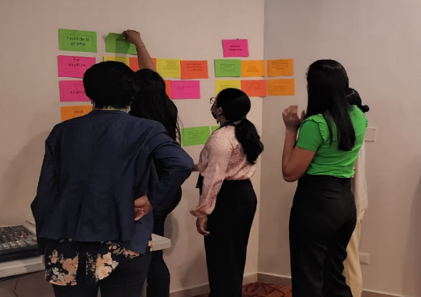
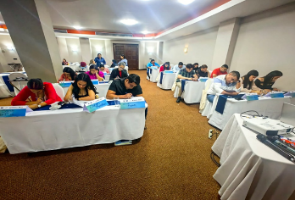

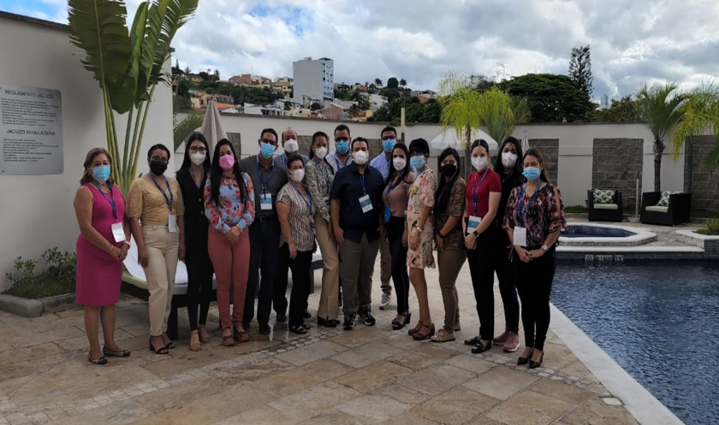
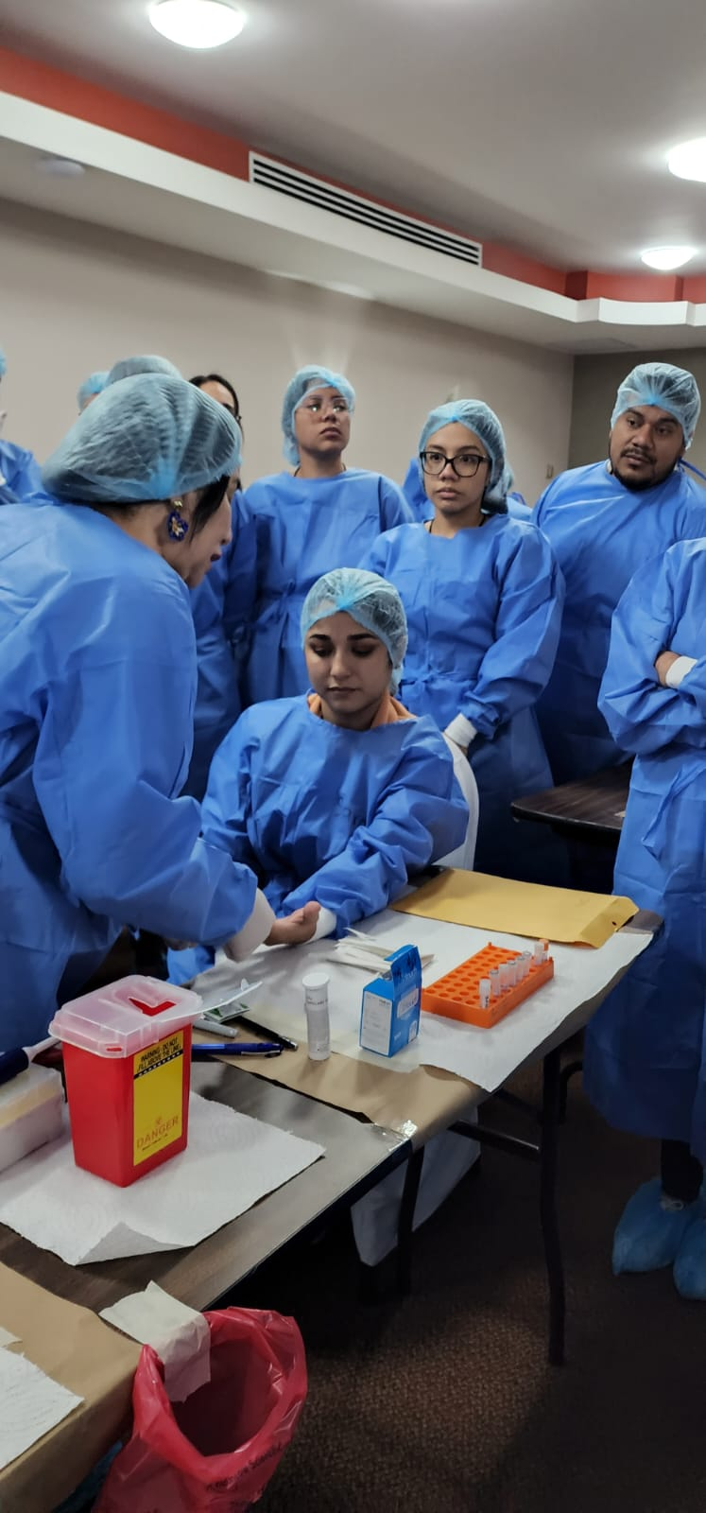
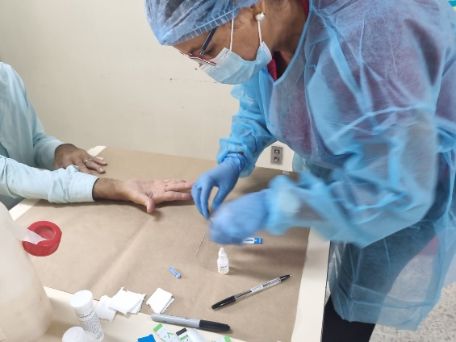
DEVELOPMENT OF NATIONAL WORKSHOPS

Slide 15
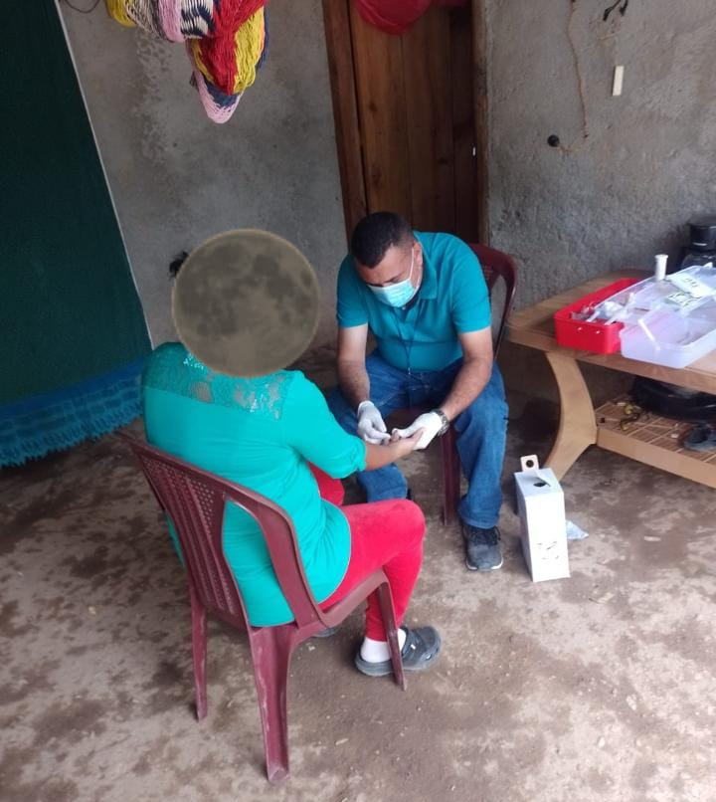
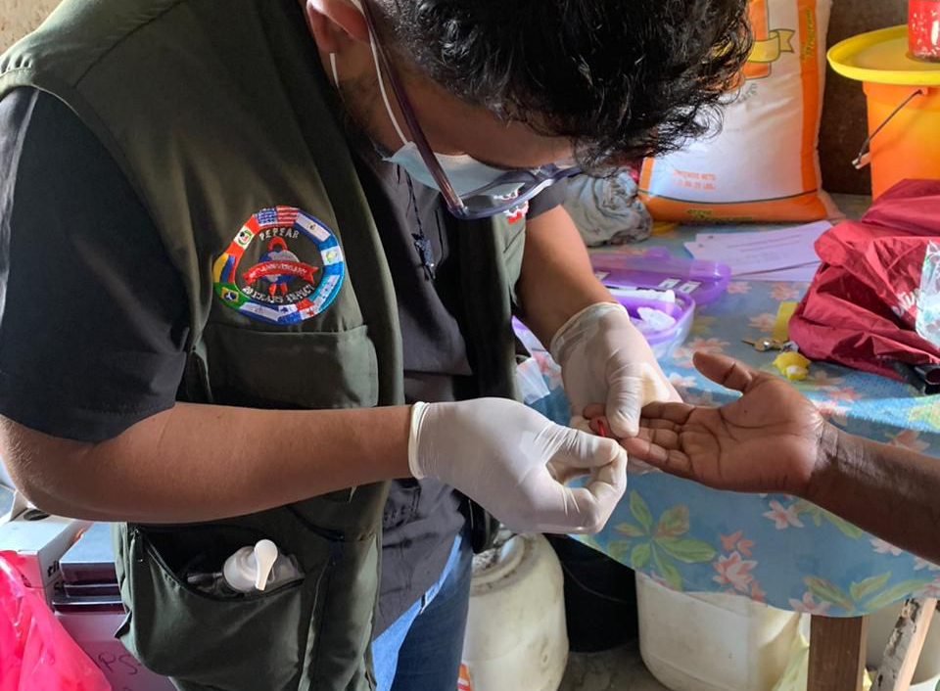

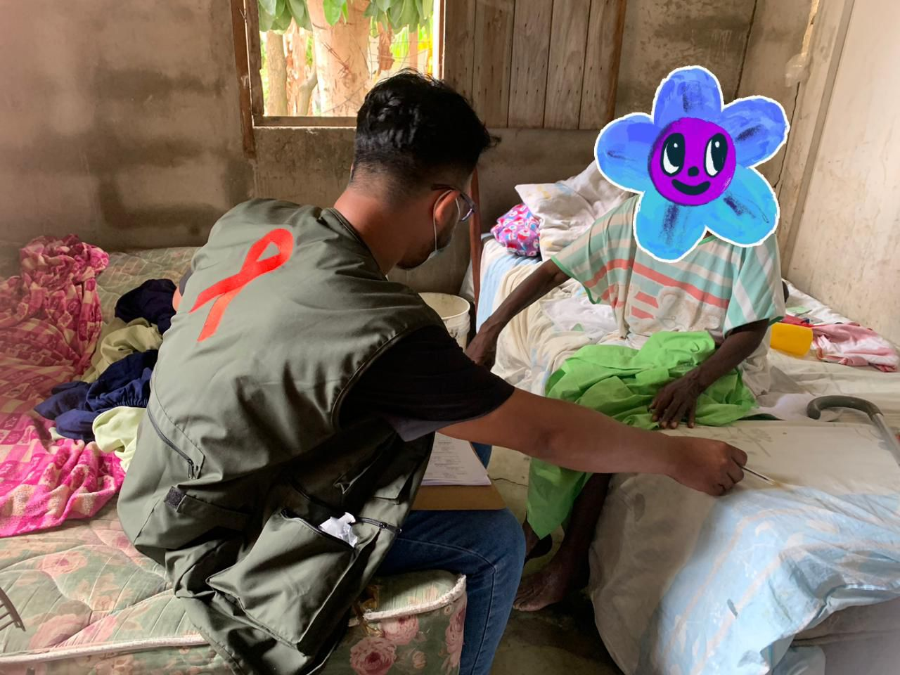
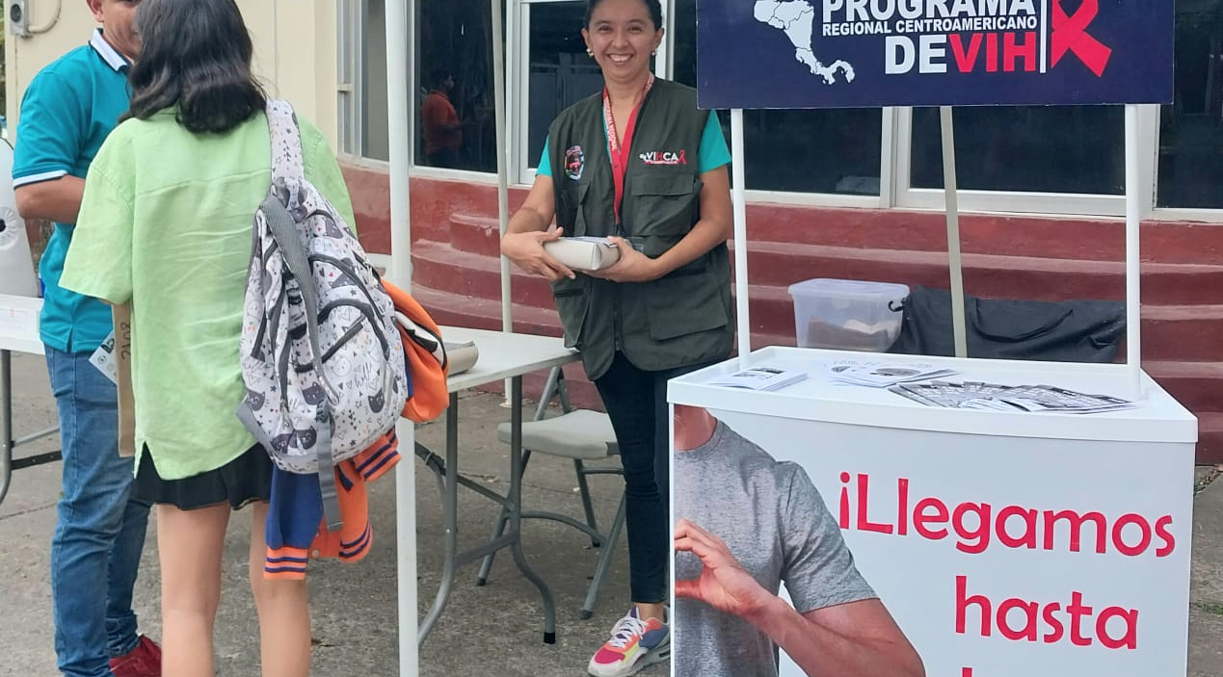
EXTRAMURAL ACTIVITIES

Slide 16
LECCIONES APRENDIDAS
The expansion of HIV testing services with personnel trained in Risk-Based Counseling has led to an increase in demand for extended hours and outreach activities for hard-to-reach populations.
Primary health care units without laboratories have increased the number of people who know their serological status.
The implementation of standardized policies and guidelines for HIV diagnosis has strengthened the capacities of all individuals conducting rapid tests, ensuring quality standards according to ISO 15189.
The standardization of information subsystems (registration books, test requests, among others) has improved data quality.
It has been implemented that all personnel conducting HIV tests must participate in the External Quality Evaluation Program (EQEP).

Slide 17

RETOS
Manage funding with implementing partners and the government to train primary health care units without laboratories (58%) in counseling and rapid HIV testing in order to achieve the first 95 pillar, where users know their serological status
Manage funding with implementing partners and the government to achieve the certification of establishments with laboratories that perform rapid HIV tests in the first phase, and later in primary health care units (UAPS)

Slide 18

¡Gracias!

